Slide 1
Decidability
Lecture -14

Slide 2
Learning outcomes
At the end of this topic you should be able to:
Recognise there are problems that are undecidable

Slide 3
Computability
What can be computed?
What are the limits of computation? Or power of computers?
Are there problems for which no algorithm can ever exist?
How can we prove this?
Intuitively, computation has to be
complete (i.e. cover all cases)
mechanistic (i.e. precise)
deterministic (i.e. same input always leads to the same result)

Slide 4
Computability
Some problems are obviously too vague to be solved by an algorithm
e.g. How big is the universe?
Some practical problems are hard, although easy to define precisely.
can a compiler determine if a program contains the possibility of an infinite loop?
Or any uninitialized variables?
Intuitively any statement should either be true or false (provided we have all the facts)

Slide 5
Computability-Types
Decidable - If there is a Turing machine which accepts and halts on every input string w. Every decidable language is Turing-Acceptable.
Undecidable-do not have any algorithmic solution!
semi-decidable; we can determine when a property is satisfied, but not when it is not
e.g. is there an odd perfect number? (a perfect number equals the sum of its proper divisors, e.g. 6 = 1+2+3; 28=…)
list of the known perfect numbers:
http://en.wikipedia.org/wiki/List_of_perfect_numbers

Slide 6
Church-Turing Thesis
Church-Turing thesis
(Standard) Turing Machines are mechanistic and deterministic.
A Complete Turing Machine M halts on all inputs
Hence, Turing machines which always halt correspond to the intuitions above

Slide 7
Church-Turing Thesis
Church-Turing thesis:
All possible models of computation are equivalent to a standard Turing machine
Any future models of computation will also be no more powerful than a standard Turing machine!
Cannot be proved; it is not a theorem!
Can only be experimentally verified
Will quantum computing disprove this? Too early to tell!

Slide 8
Universal Turing Machine
The Universal Turing machine
Takes another Turing machine M as input
Simulates the actions of M
Model for “real” computers
i.e. input is both data and instructions

Slide 9
Decision Problem
is a question in some formal system with a ‘yes’ or ‘no’ answer, depending on the values of some input
E.g.
Given a number x, is x a prime number?
Yes
Input
Algorithm
No

Slide 10
Decision Problem
A decision problem is decidable if there a TM exists to solve it
A decision problem is undecidable if no TM exists to solve it

Slide 11
Undecidable Problems
Undecidable problems for grammars
As Turing machines are equivalent to unrestricted grammars, we expect undecidable problems there
Let G be an unrestricted grammar.
Is w ∈ L(G)?
Is λ ∈ L(G)?
Is L(G₁) = L(G₂)?
Is L(G) = Ø?

Slide 12
Undecidable Problems
There are some context-free language properties which are undecidable:
For a context-free grammar G, is L(G) = ∑*?
For context-free grammar G₁, G₂, is L(G₁) = L(G₂)?
For PDAs M₁ and M₂, is L(M₁) = L(M₂)?
For PDA M, does M have the minimum number of states?
Some properties are decidable for CFG
w ∈ L(G) and L(G) = Ø are decidable (we have seen this earlier)

Slide 13
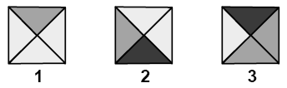
Tiling Problem
Known as Wang tiles (or Wang dominoes).
Given a set of tile designs T:
Can we cover any rectangular area using only designs from T, where:
Rotation is not allowed. The solution must be able to cover all possible rectangular shapes
Edges that touch each other must have the same color.

Slide 14
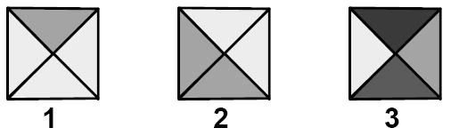
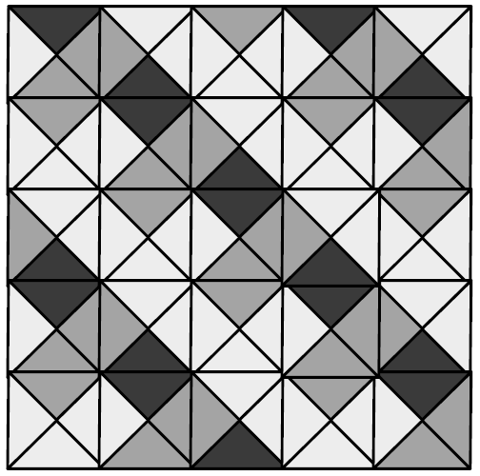
Tiling Problem cont..
However, suppose we change the tiles to these…
With these combinations a 3*3 floor cannot be tiled

Slide 15
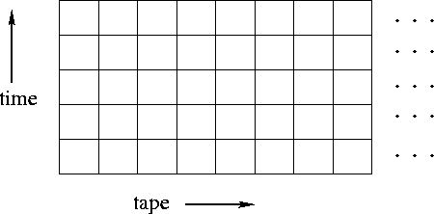
Tiling Problem cont..
The problem of whether a set of Wang tiles can cover an infinite plane or not, is undecidable.
Robert Berger proved this by constructing a Turing machine which tiles the plane iff the Turing machine does not halt
Generate tiling from the Turing machine by taking configurations of M’s and placing them on top of each other

Slide 16
Tiling Problem cont..
The un-decidability of the halting problem then implies the un-decidability of Wang's tiling problem
The idea is that a tiling pattern corresponds to an infinite computation in M. If there is no such tiling, then M will eventually halt (and hence get “stuck”) ??????

Slide 17
Tiling Problem cont..
Edge rules:
horizontal: elements of configuration
vertical: state information, if present
The idea is that a tiling pattern corresponds to an infinite computation in M. If there is no such tiling, then M will eventually halt (and hence get “stuck”)

Slide 18
Limitations
Undecidable problems are often interesting and useful.
Whilst termination of programs dealing with such problems cannot be guaranteed, this is often not a problem in practice
Programmers generally write programs which terminate.
The only tricky part tends to come with programs which take other programs as input
There are actually classes of undecidable problems -- the differences being what information is needed in order to decide the problem

